Slide 1
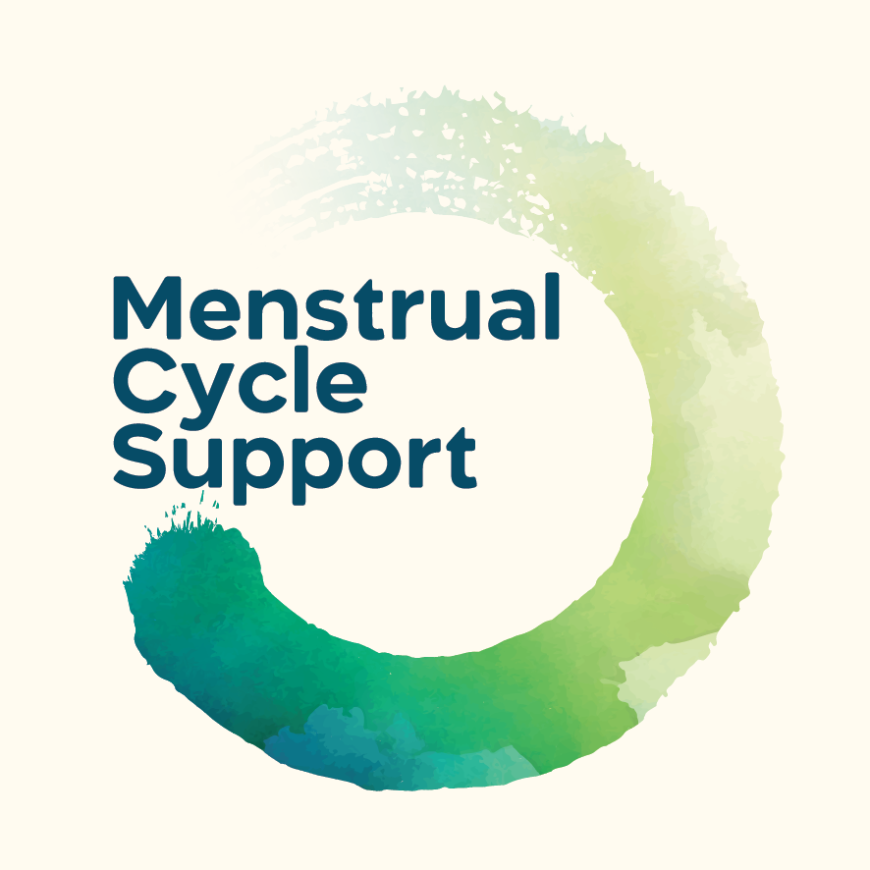
Supporting your Pre/Teen
Through the Menstrual Cycle
Online Workshop
2nd July 2026
Kate Shepherd Cohen, CEO
kate@menstrualcyclesupport.com
menstrualcyclesupport.com

Slide 2
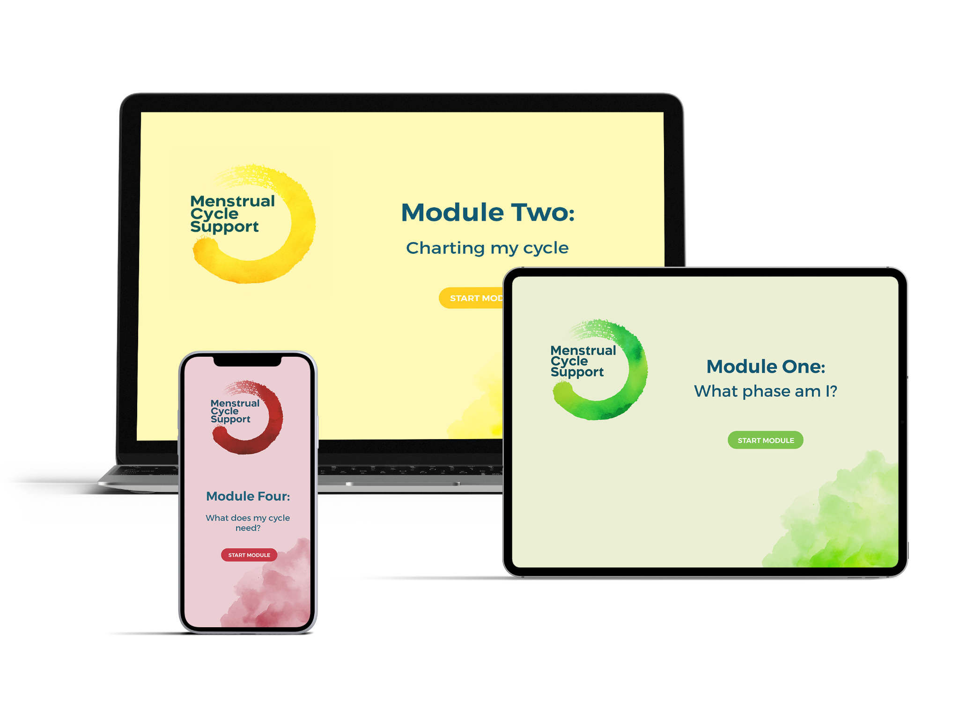


We provide menstrual literacy courses and training
Our free digital courses are available as an intervention through NHS referral as they teach how ‘to be with and manage the menstrual cycle’.
The courses are also available for schools as part of our School Accreditation Scheme

Slide 3

6 Month Pilot January-July 2026
Staff training session
Access for all students to our 30 minute digital course
Support Worker training session
Access for all staff to adult course
School Visits
Posters / Referral Cards / Window Stickers
Parent workshop
Impact Report

Slide 4
What We’ll Cover Today
Why Menstrual Health Matters
The Menstrual Cycle - The Essentials
What’s normal - and what’s not
Supporting your child at home
Where to get help
This is a safe, inclusive & non-judgemental space
Questions are welcome throughout - feel free to use the chat

Slide 5
6 in 10 teens
don’t know when to seek medical help for problem periods
420 / 700 in a school of 1500
MCS Teen Menstrual Health Literacy Survey 2024
(in collaboration with Endometriosis UK, conducted by Censuswide)
WHY THIS MATTERS
Up to 90%
Up to 10%
of adolescents experience pathology-free period pain
(primary dysmenorrhea).
Kciuk & Kives (2021)
630 / 700 in a school of 1500
of adolescents have secondary dysmenorrhea
Harel (2006)
70 / 700 in a school of 1500
36%
Put in chat box:
1-3 words to describe how periods were talked about in your house growing up
76%
Missed school
as a result of period symptoms
Wellbeing of Women (2023)
252/700 in a school of 1500
Teen Literacy Survey (2024)
Say their mental health is affected as a result

Slide 6
2. UNDERSTANDING THE CYCLE
Day 1 -
First day of period
The Menstrual Cycle is a Whole Body Process, not just a monthly bleed

Slide 7
Day 1 -
First day of period
Notes:
Draw the archetypal menstrual cycle. Let’s go! (pre-ov / ov / pre-men/ men) (Seasons) (Follicular / luteal)
It is a naturally regenerative cycle of two halves: a rise in outward energy in the first half, and a decline in outward energy in the second half.
It has two poles: Ovulation: which is peak outward full-production energy, and
menstruation, which is peak inward restorative energy.
It has four distinct phases much like the seasons of the year: spring, the first week more or less after menstruation, playful new energy, pre-ovulation , summer, ovulation: the superhero mother, worker, friend, can spin 100 plates whilst doing a dance and staying up all night,
Autumn, drawing down and sorting out taking no nonsence premensrtrum,
Winter hibernation menstruation.
In our 24/7 consumerist culture there’s no space or time for menstrual rest - there’s not even time to go to the toilet.
Often we feel the tension of our natural cycle under stress in our Autumn, it’s that premenstrual rage, which often occurs in my experience because we’re still going at full summertime pelt, yet our system is wanting to slow right down for survival.
We can all see how our culture of perpetual productivity is contributing to climate change, mass extinction and systemic environmental collapse.
Our menstrual cycle is guiding us to live more sustainably.

Slide 8
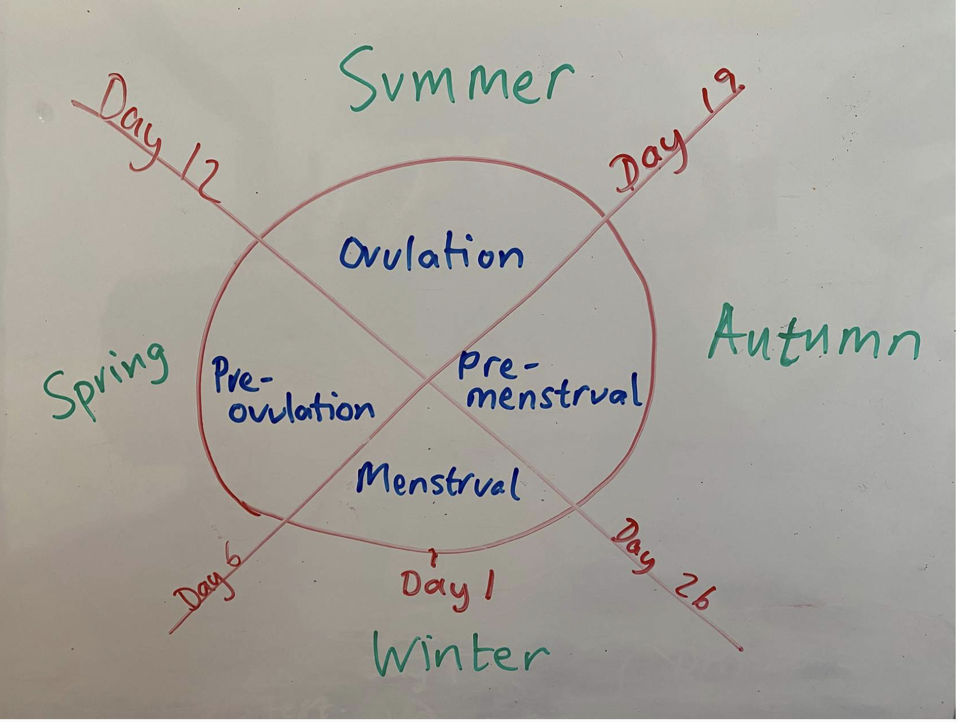
Mood, Energy, Sleep, Appetite, Social Needs - all change through the cycle.
Notes:
It is a naturally regenerative cycle of two halves: a rise in outward energy in the first half, and a decline in outward energy in the second half.
It has two poles: Ovulation: which is peak outward full-production energy, and
menstruation, which is peak inward restorative energy.
It has four distinct phases much like the seasons of the year: spring, the first week more or less after menstruation, playful new energy, pre-ovulation , summer, ovulation: the superhero mother, worker, friend, can spin 100 plates whilst doing a dance and staying up all night,
Autumn, drawing down and sorting out taking no nonsence premensrtrum,
Winter hibernation menstruation.
In our 24/7 consumerist culture there’s no space or time for menstrual rest - there’s not even time to go to the toilet.
Often we feel the tension of our natural cycle under stress in our Autumn, it’s that premenstrual rage, which often occurs in my experience because we’re still going at full summertime pelt, yet our system is wanting to slow right down for survival.
We can all see how our culture of perpetual productivity is contributing to climate change, mass extinction and systemic environmental collapse.
Our menstrual cycle is guiding us to live more sustainably.

Slide 9
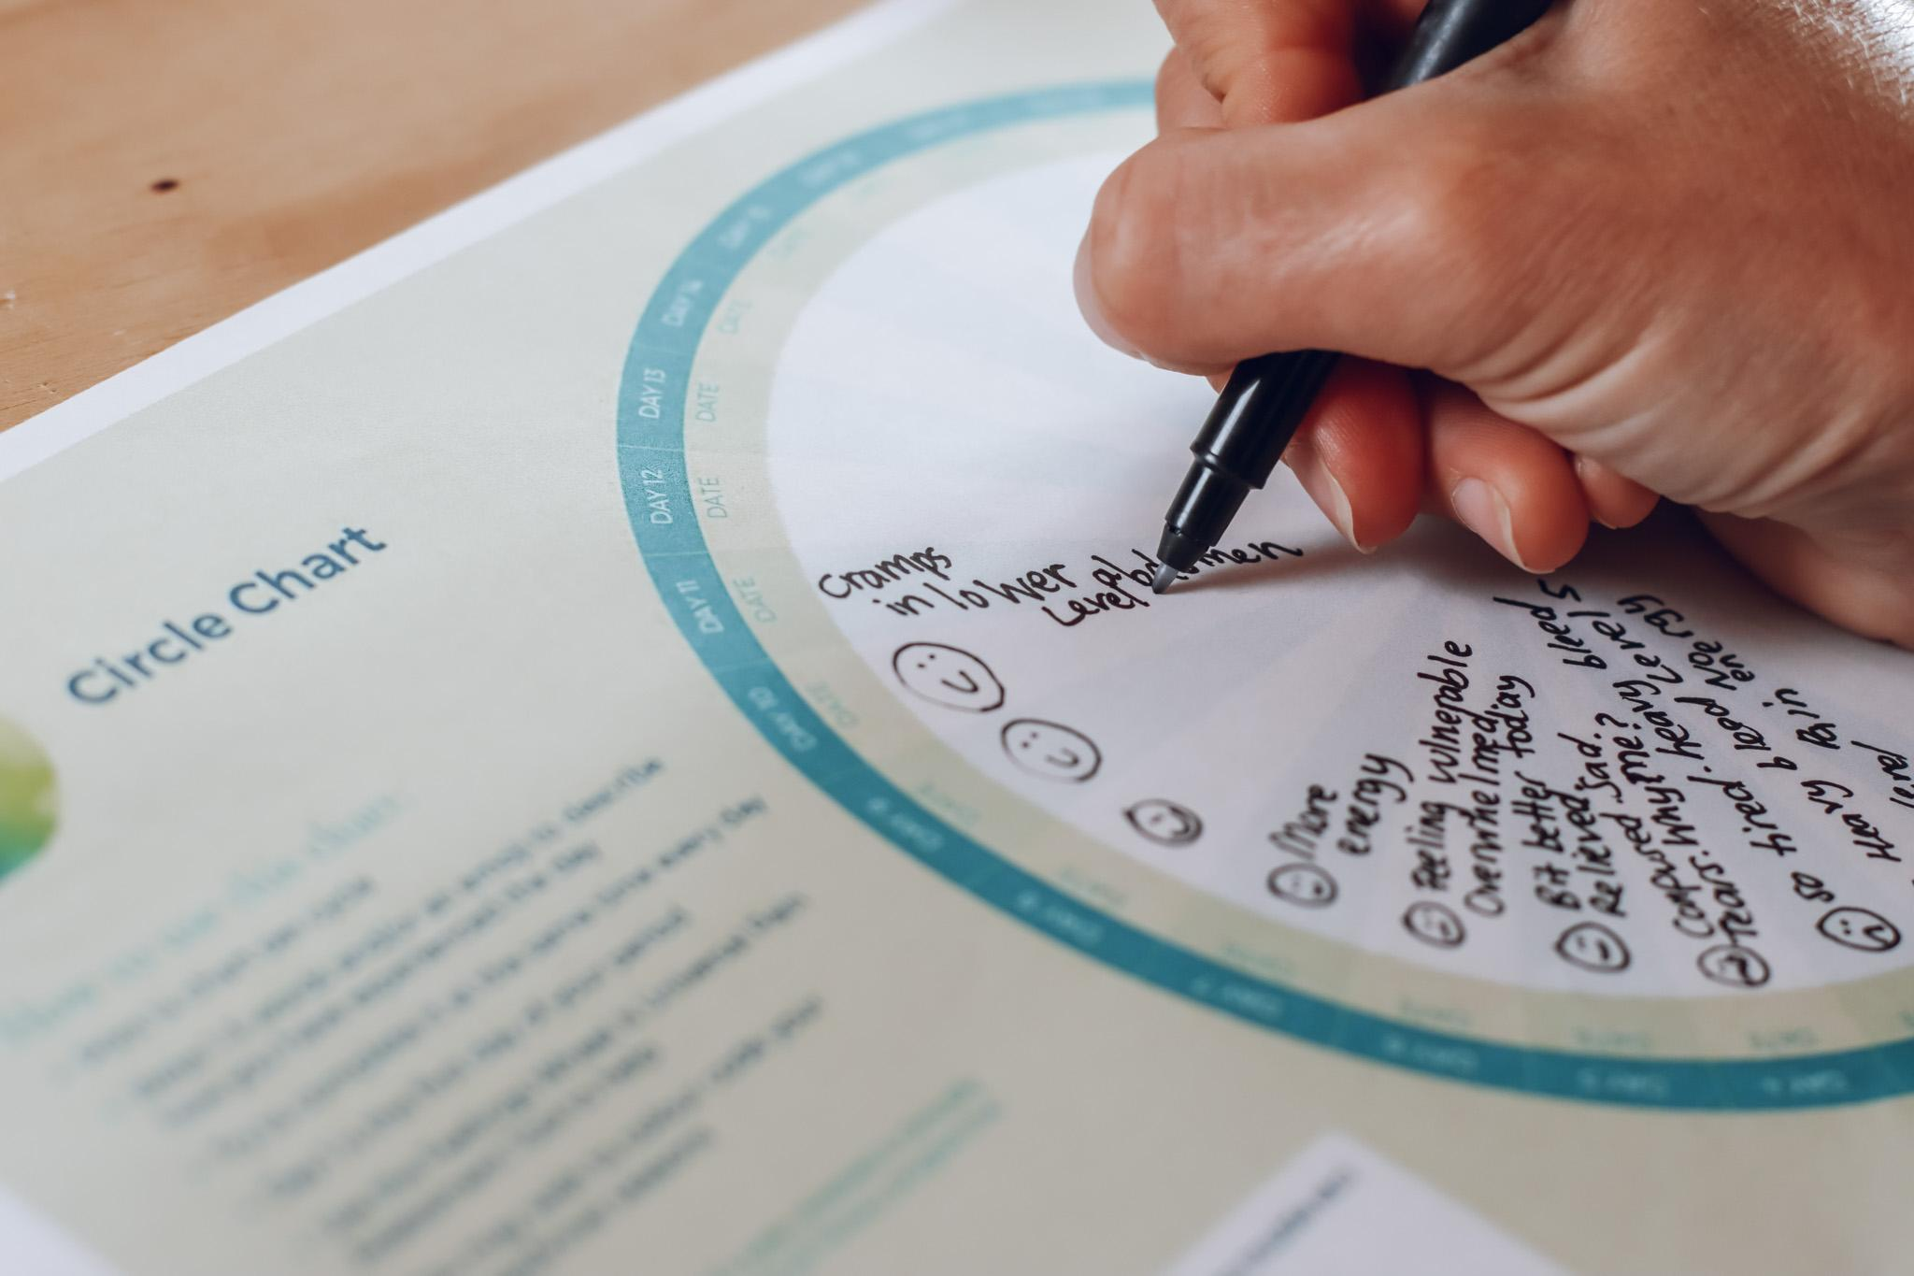
Recognising Patterns is Key
Notes:
It is a naturally regenerative cycle of two halves: a rise in outward energy in the first half, and a decline in outward energy in the second half.
It has two poles: Ovulation: which is peak outward full-production energy, and
menstruation, which is peak inward restorative energy.
It has four distinct phases much like the seasons of the year: spring, the first week more or less after menstruation, playful new energy, pre-ovulation , summer, ovulation: the superhero mother, worker, friend, can spin 100 plates whilst doing a dance and staying up all night,
Autumn, drawing down and sorting out taking no nonsence premensrtrum,
Winter hibernation menstruation.
In our 24/7 consumerist culture there’s no space or time for menstrual rest - there’s not even time to go to the toilet.
Often we feel the tension of our natural cycle under stress in our Autumn, it’s that premenstrual rage, which often occurs in my experience because we’re still going at full summertime pelt, yet our system is wanting to slow right down for survival.
We can all see how our culture of perpetual productivity is contributing to climate change, mass extinction and systemic environmental collapse.
Our menstrual cycle is guiding us to live more sustainably.

Slide 10
2. WHAT’S NORMAL
Starting period anytime bt. 8-16 yrs
Irregularity in early years
Some discomfort
Changes in mood
Different flow patterns
Recognising Patterns is Key
Notes:
It is a naturally regenerative cycle of two halves: a rise in outward energy in the first half, and a decline in outward energy in the second half.
It has two poles: Ovulation: which is peak outward full-production energy, and
menstruation, which is peak inward restorative energy.
It has four distinct phases much like the seasons of the year: spring, the first week more or less after menstruation, playful new energy, pre-ovulation , summer, ovulation: the superhero mother, worker, friend, can spin 100 plates whilst doing a dance and staying up all night,
Autumn, drawing down and sorting out taking no nonsence premensrtrum,
Winter hibernation menstruation.
In our 24/7 consumerist culture there’s no space or time for menstrual rest - there’s not even time to go to the toilet.
Often we feel the tension of our natural cycle under stress in our Autumn, it’s that premenstrual rage, which often occurs in my experience because we’re still going at full summertime pelt, yet our system is wanting to slow right down for survival.
We can all see how our culture of perpetual productivity is contributing to climate change, mass extinction and systemic environmental collapse.
Our menstrual cycle is guiding us to live more sustainably.

Slide 11
…AND WHAT’S NOT: RED FLAGS
Pain:
Regularly missing school
vomiting
fainting
dread
Bleeding:
Flooding / soaking quickly
large clots
Periods lasting longer than 7 days
Mood:
severe anxiety
rage
low mood before periods
How many of us were taught to believe pain was just part of it?
(add Y to chat box)
Recognising Patterns is Key
Notes:
It is a naturally regenerative cycle of two halves: a rise in outward energy in the first half, and a decline in outward energy in the second half.
It has two poles: Ovulation: which is peak outward full-production energy, and
menstruation, which is peak inward restorative energy.
It has four distinct phases much like the seasons of the year: spring, the first week more or less after menstruation, playful new energy, pre-ovulation , summer, ovulation: the superhero mother, worker, friend, can spin 100 plates whilst doing a dance and staying up all night,
Autumn, drawing down and sorting out taking no nonsence premensrtrum,
Winter hibernation menstruation.
In our 24/7 consumerist culture there’s no space or time for menstrual rest - there’s not even time to go to the toilet.
Often we feel the tension of our natural cycle under stress in our Autumn, it’s that premenstrual rage, which often occurs in my experience because we’re still going at full summertime pelt, yet our system is wanting to slow right down for survival.
We can all see how our culture of perpetual productivity is contributing to climate change, mass extinction and systemic environmental collapse.
Our menstrual cycle is guiding us to live more sustainably.

Slide 12
3. HOW TO SUPPORT YOUR PRE/TEEN
Believe them
Track symptoms
Get curious about patterns
Reduce shame - what day are you?
Prepare ahead - what phase are you in? (What’s next?)
Advocate early
Complete the online MCS course
Language matters

Slide 13
5. INTRODUCING THE COURSE
PLUS course for staff / parents with a menstrual cycle & peri/menopause
4x 10 minute self-paced modules, available on all devices - do it at home or at school
What the course gives:
body literacy
symptom awareness
tools for support
guidance on when to seek help
As recommended by GPs*
Trusted by clinicians**
Increases confidence to talk about the cycle and seek support + improves relationship with menstrual cycle***
For further course info, please see Appendix 3
*Menstrual Cycle Support available in over 500 GP surgeries across the UK on social prescription
** Peer reviewed and endorsed by the Royal College of Obs/Gyn (RCOG); the Women’s Health Ambassador (Eng), leading clinicians. Course created in partnership with leading menstrual health charity, Endometriosis UK.
***Please see highlights from our Independently compiled Impact Report, which used an NHS approved methodology Appendix 4C

Slide 14
6. Q&A + ONE TAKEAWAY
Knowledge reduces fear.
Understanding reduces shame.
Support changes lives.
CHATBOX: What’s one thing you’ll do differently after today?

Slide 15
Thank you
menstrualcyclesupport.com
kate@menstrualcyclesupport.com

Slide 16






